Slide 1

EEG Preprocessing Tutorial
CCPL - Lyndon Rakusen

Slide 2
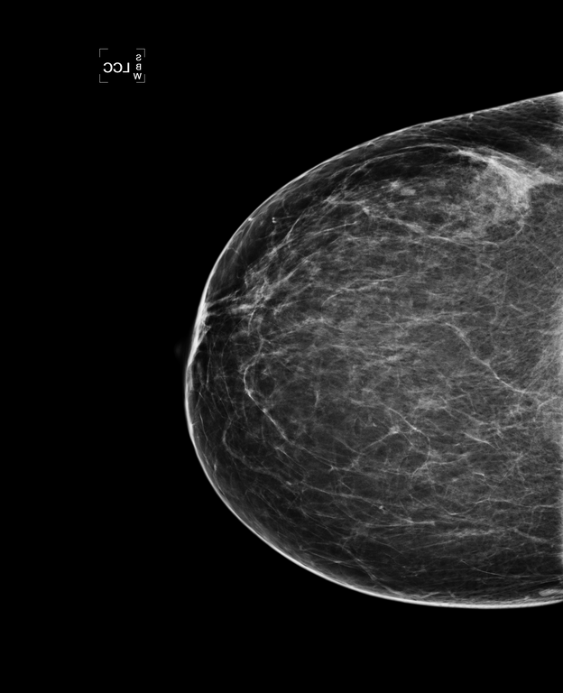
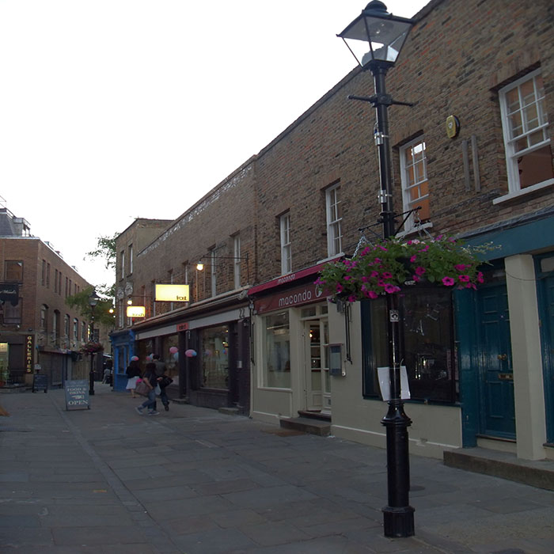
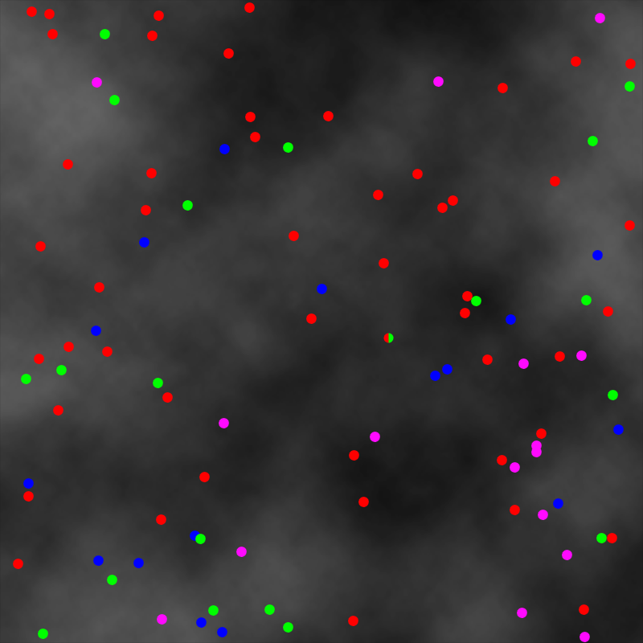
Our Datasets/Projects
Mammography EEG
Radiologists
Naives Training
Attentional Blink EEG
Dots
Scenes

Slide 3
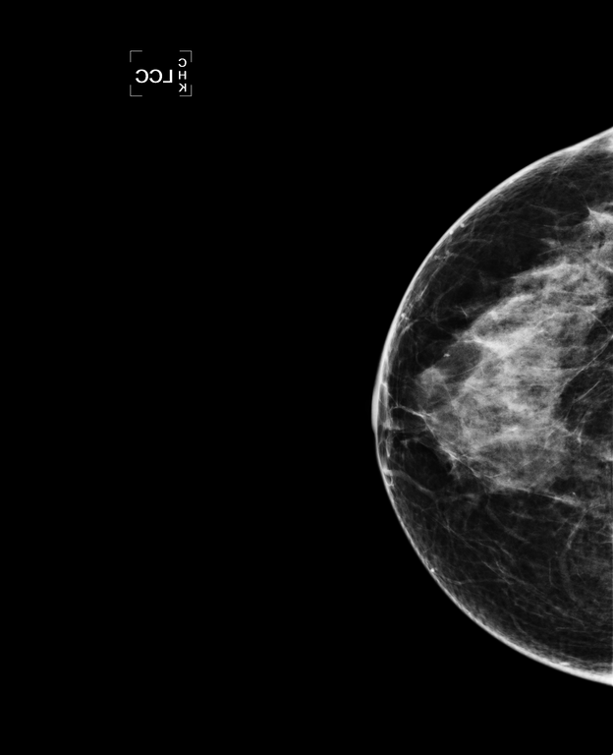
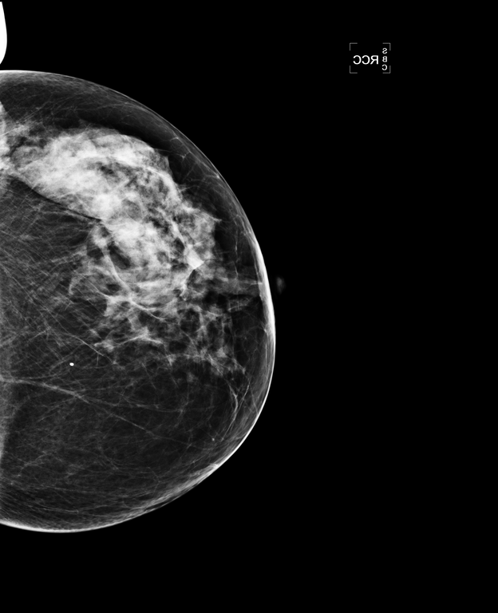
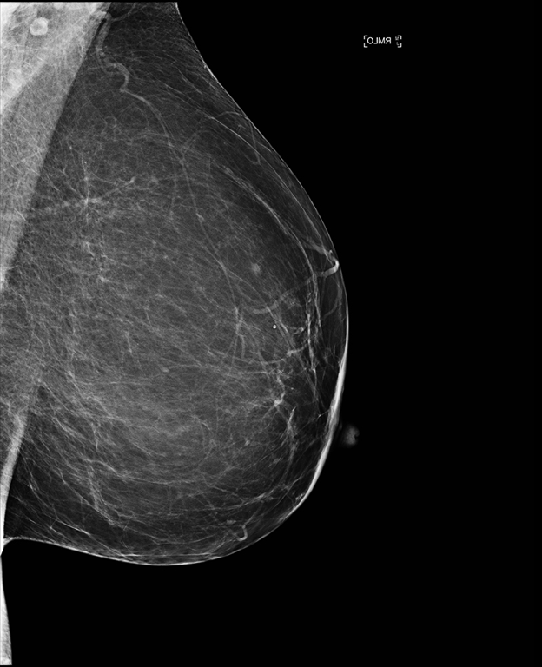
Mammography EEG Design
400 trials total (+30 practice)
Four different kinds of mammogram stimulus:
160 Normal (no cancer)
60 Obvious
60 Subtle
120 Global (Prior/Contralateral)
Each trial consists of a unilateral mammogram for 500 ms, a mask for 500 ms, a response window of 2 seconds, and a jittered ISI between 1 and 2 seconds.
Participant responded Abnormal or Normal (yes or no)

Slide 4
Mammography EEG Design
Radiologists
5 experienced mammographers from York hospital
1 EEG test session
Naives
15 participants
2 EEG test sessions, 9 online training sessions
Baseline start: -0.4s, Baseline end: -0.2s
Event start: 0s, Event end: 2.0s

Slide 5
Attentional Blink EEG Experiments
36 participants (mainly students)
Four conditions with multiple levels:
Scenes or dots
Selective (S) or non-selective (NS)
S-NS, NS-S, S-S, and NS-NS
Identify scene vs object
Time lag 1, 2, 3, and 4

Slide 6
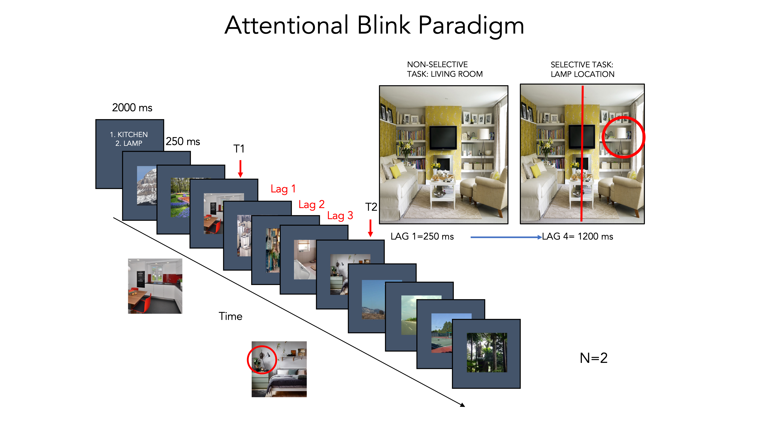

Slide 7
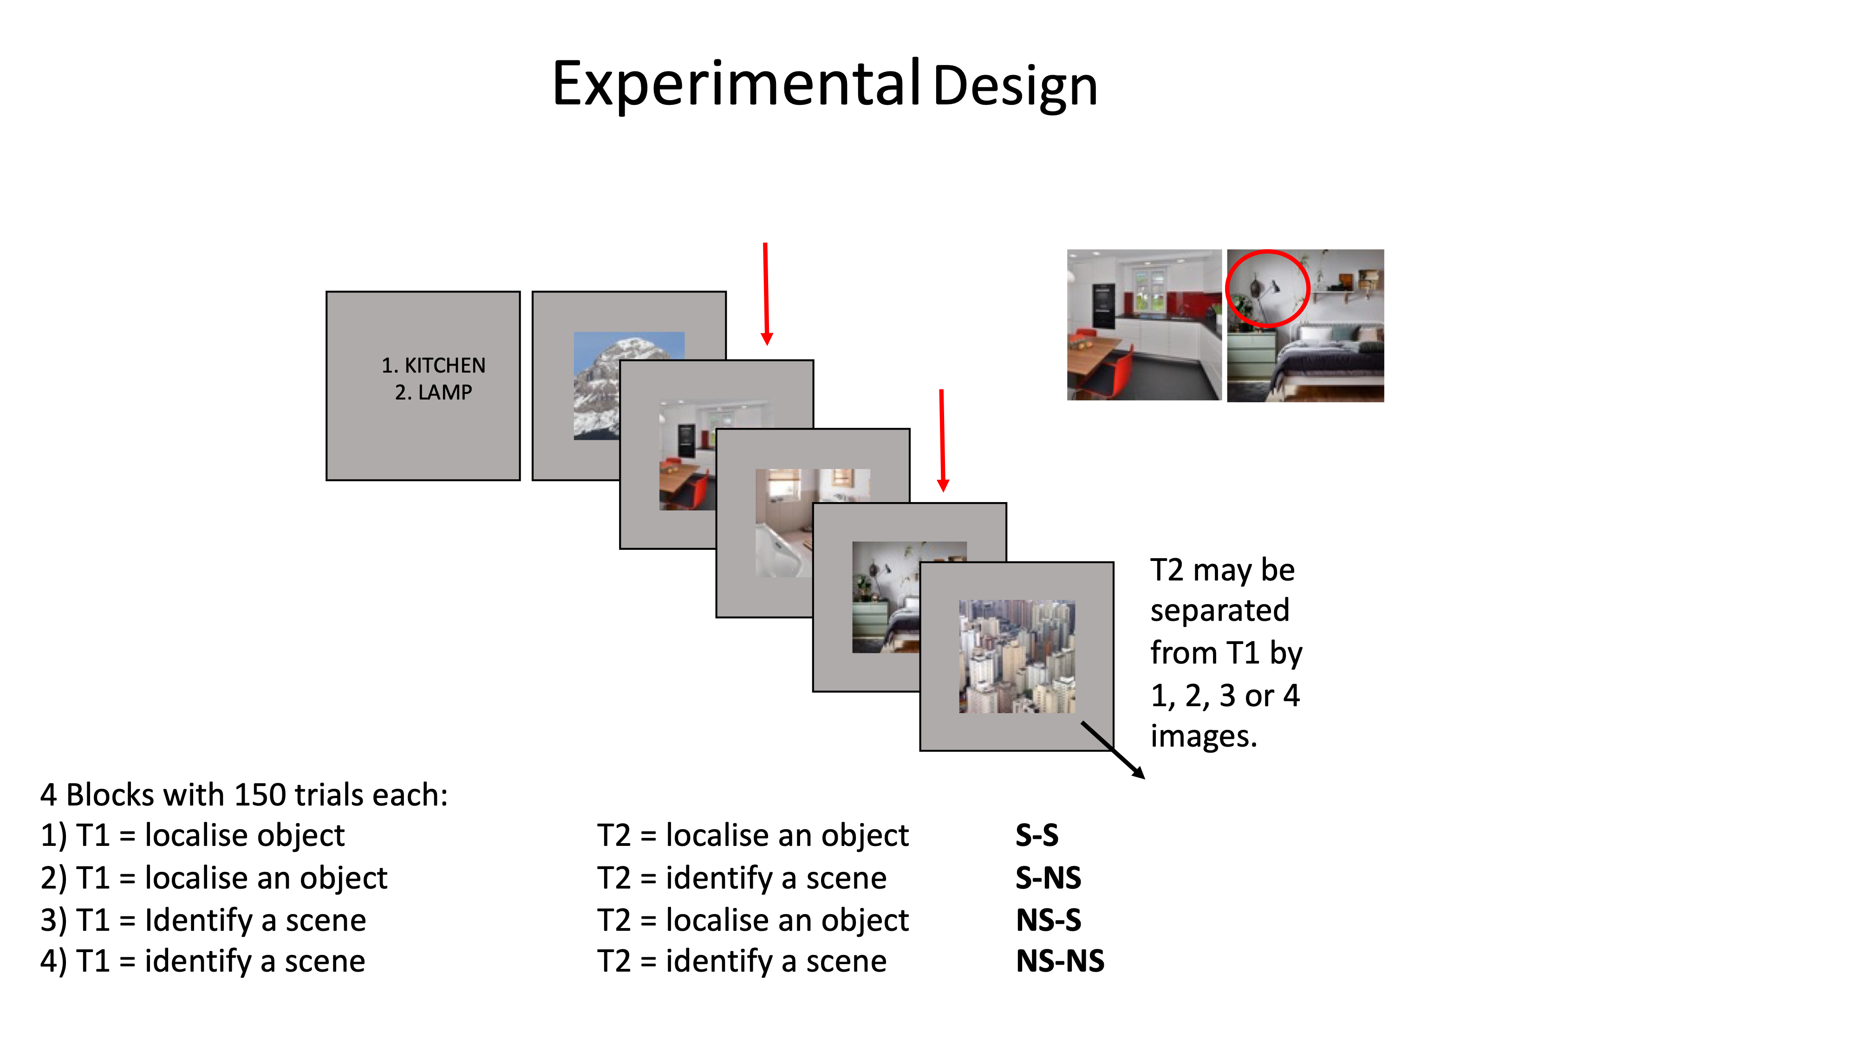

Slide 8
Attentional Blink Dots
Predominant colour (NS)
Red, green, blue, or pink
Bisected dot (S)
Green half: left or right

Slide 9
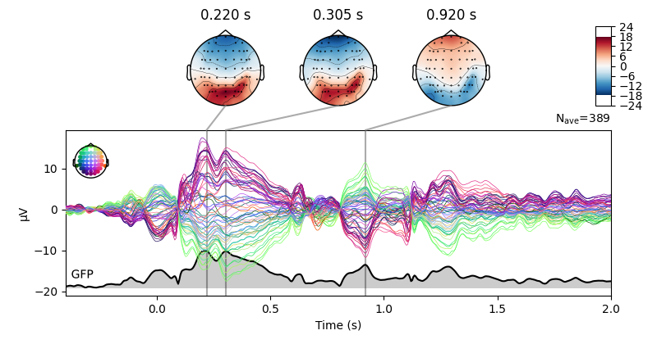
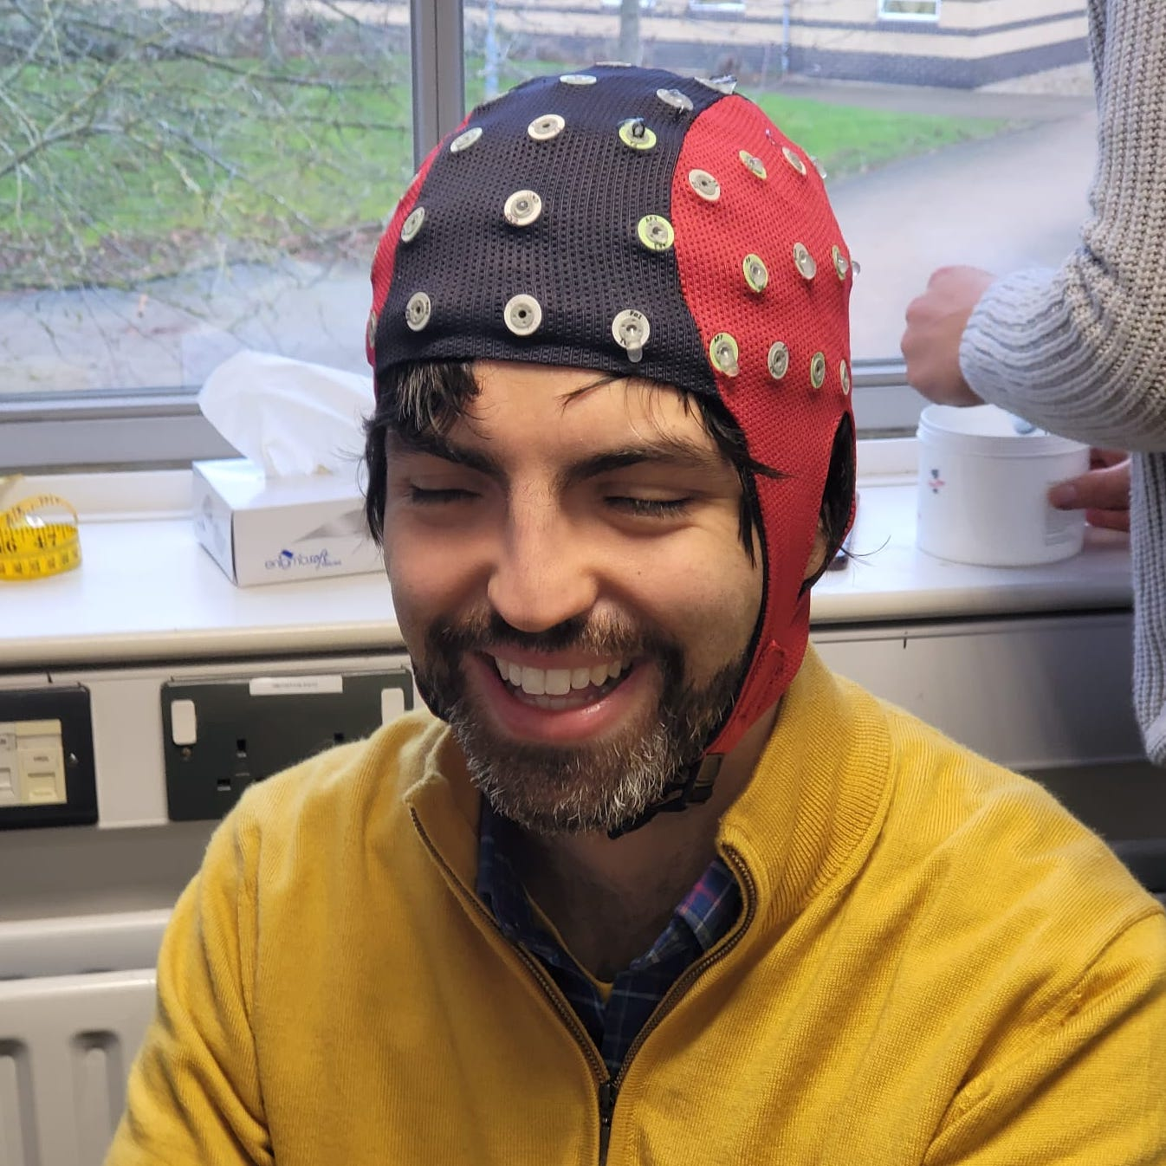
EEG Data: The Basics
64 electrodes/channels
Measuring tiny charges on the scalp
1 reference channel (Cz)
Subtracted from the other channels
1 eye channel (EOG)
Measures blinks for cleaning signal later
Time locked triggers/events sent from the testing PC

Slide 10

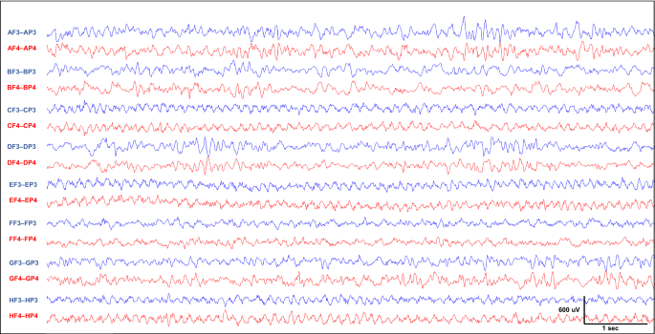
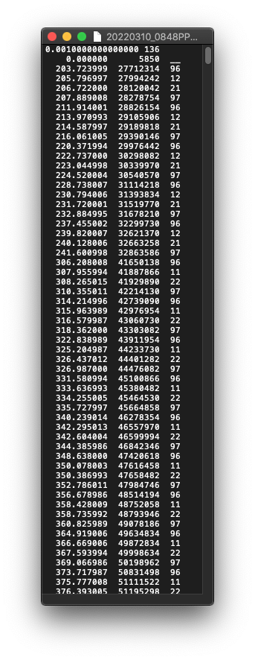
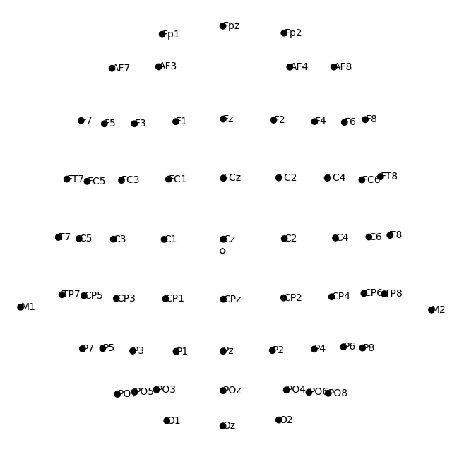
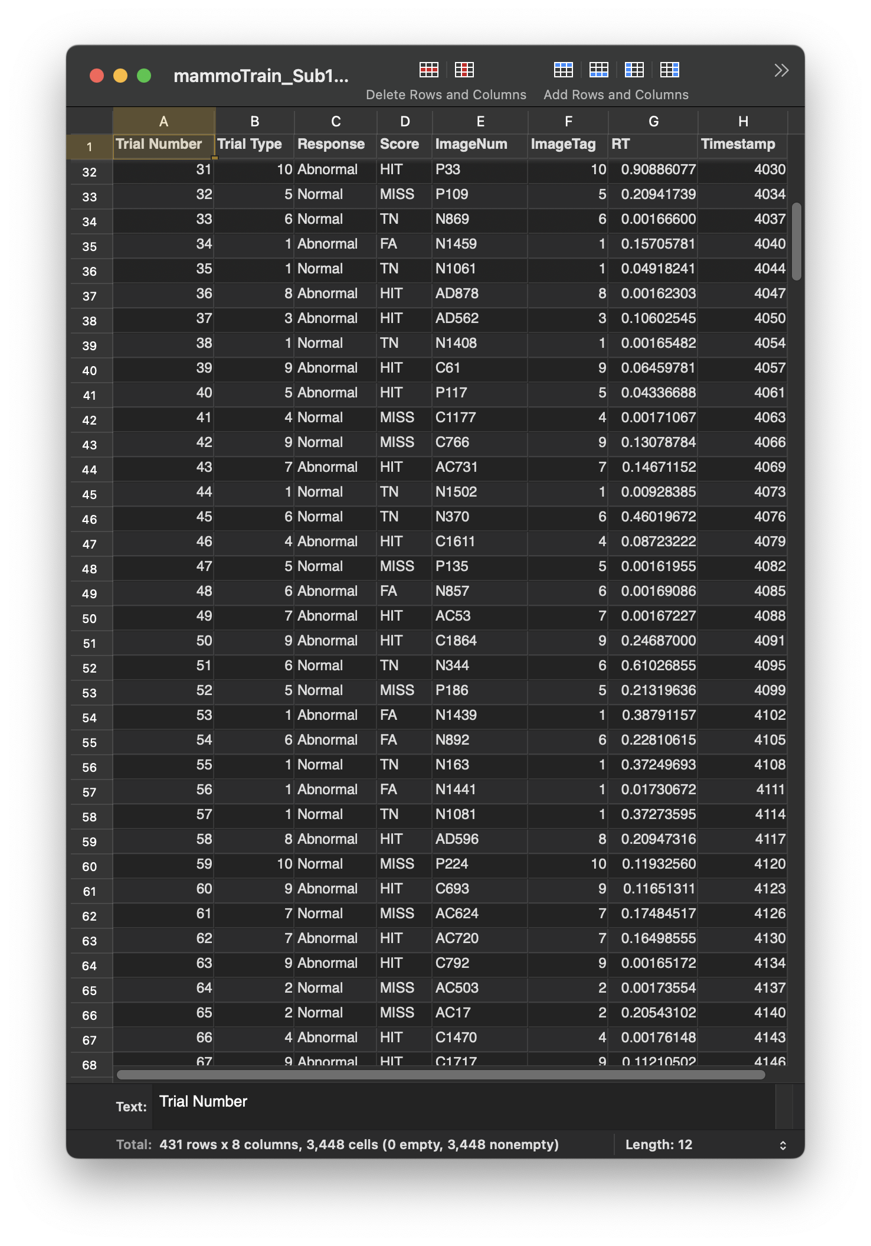
Preprocessing Ingredients
Raw EEG data files (.fif)
Trigger files (.trg)
Behavioural data (.csv)
Montage file (.xyz)

Slide 11
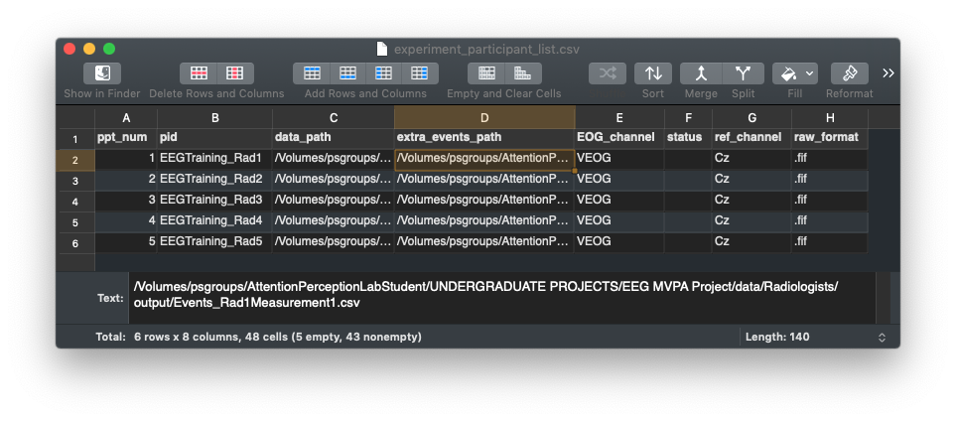
Other Ingredients
EEGTraining_Sessions.py
Participant list .csv file with the header:
ppt_num, data_path, extra_events_path, pid, EOG_channel, status, ref_channel, raw_format
trigger labels .csv file with the header:
label, value, active
EEGpykit project - a module created by me
https://github.com/llr510/EEGpykit
A preprocessing output directory
e.g 'output_directory/'

Slide 12
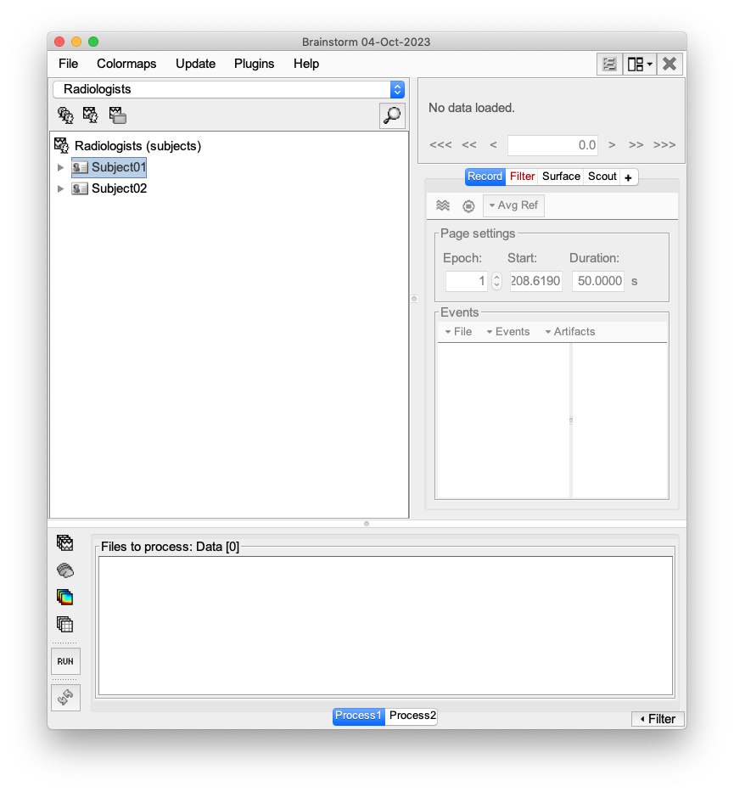


Preprocessing - The Hard Way
MATLAB
Brainstorm
GUI based preprocessing (and analysis)
https://neuroimage.usc.edu/brainstorm/Installation
https://neuroimage.usc.edu/brainstorm/Tutorials

Slide 13




Preprocessing Tools
Python >=3.8:
Miniconda - https://docs.conda.io/projects/miniconda/en/latest/
Pycharm Community Edition - https://www.jetbrains.com/pycharm/download/
MNE - https://github.com/mne-tools/mne-python

Slide 14
A Brief Python Aside
Python is a programming language and has:
Variables - store information under a name
my_var_can = integers, strings, lists, arrays, other variables, pretty much anything
Maths - it’s a big fancy calculator
+, -, *, /, **, math.sqrt()
Logic - do a thing if the right conditions are met
if, elif, else
Loops - do a thing multiple times
for, while
Functions - reuse the same bit of code in different places without writing it all out again
def(some, arguments), return
Modules - reuse you own and other people’s scripts
import
“Yo dawg, I heard you like code so we loaded code into your code so you can run code while you code”
https://www.w3schools.com/python/

Slide 15
EEGpykit Module Requirements
Module | Suggested Version | Notes
mne | 1.1.1
mne-faster | 1.1
numpy | 1.23.3 | issues when using in conda environment
scikit-learn | 1.1.2
pandas | 1.5.0

Slide 16
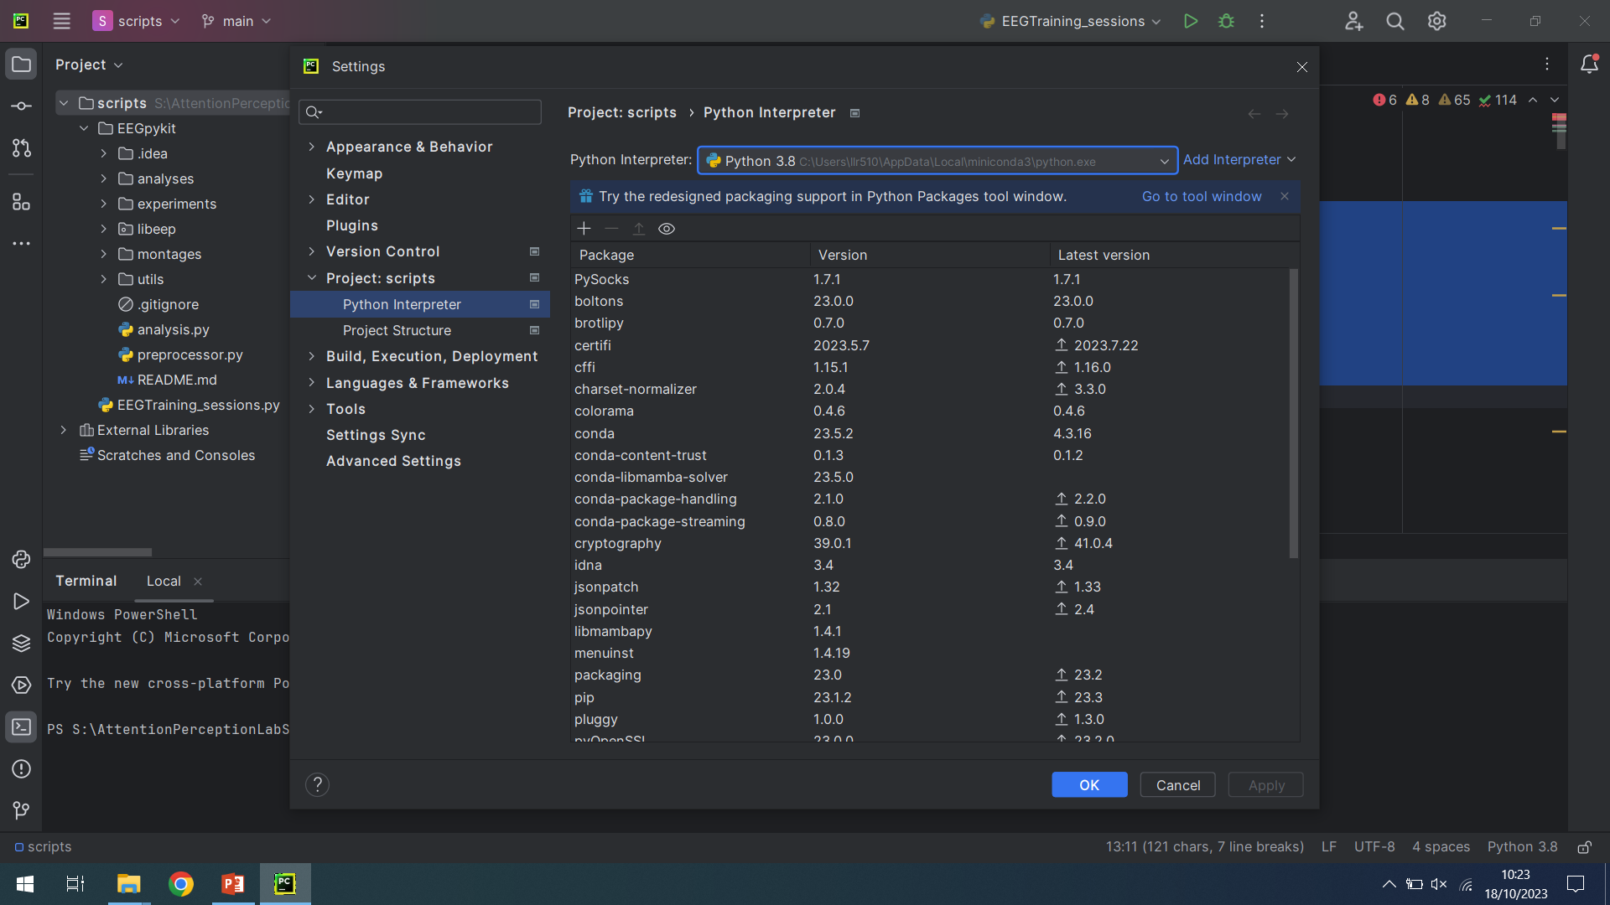
Creating a Python Environment

Slide 17
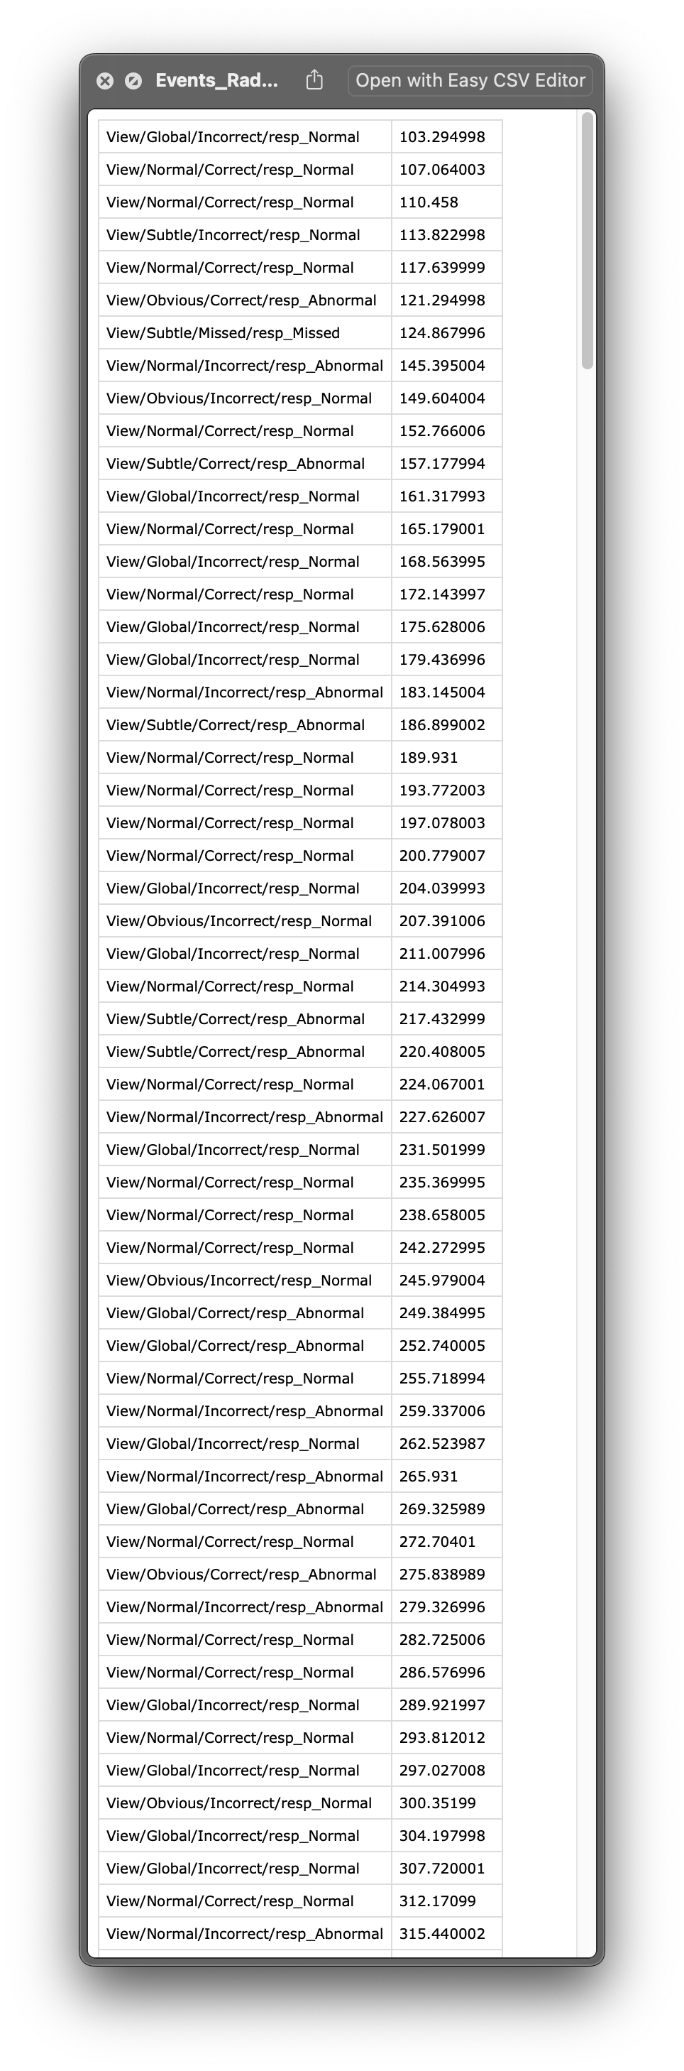
Pre-preprocessing
EEGTraining_Sessions.py
Used to create labelled event file from behavioural data + trigger files
Columns: label, event time
Will be used to label Epochs
+
=

Slide 18
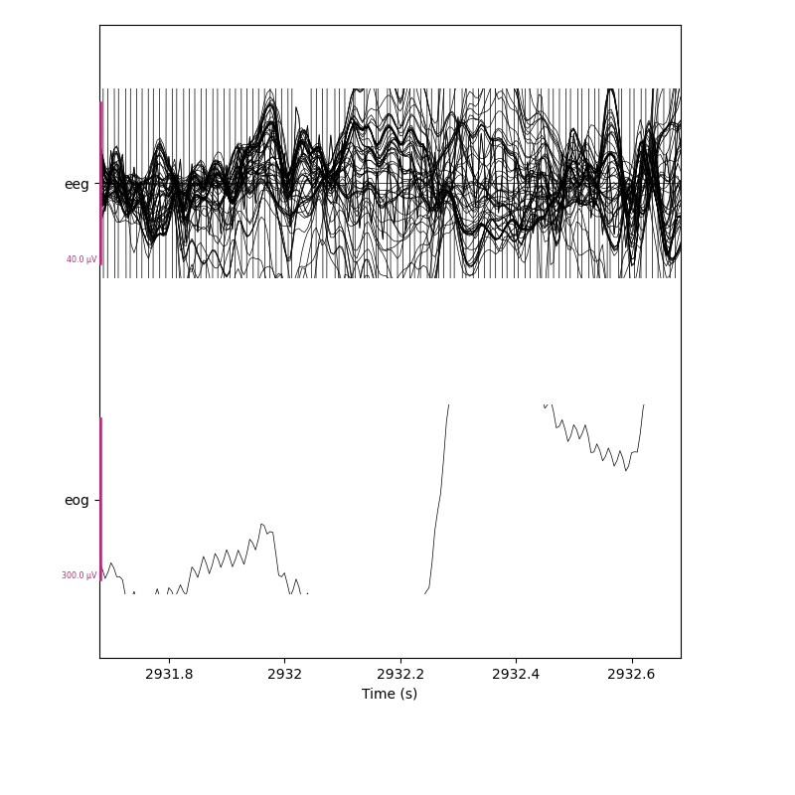
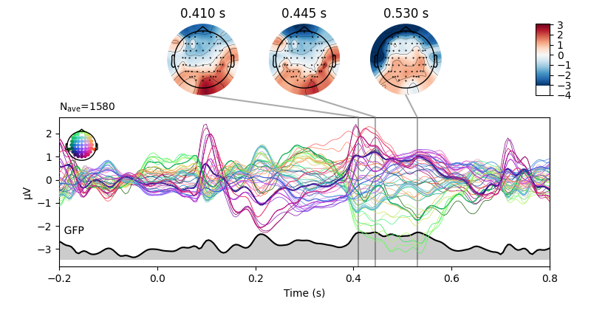
MNE Terminology
Objects:
Raw - continuous EEG recording.
Epoch - raw data split into pieces time locked to event.
Evoked - average of multiple epochs.

Slide 19
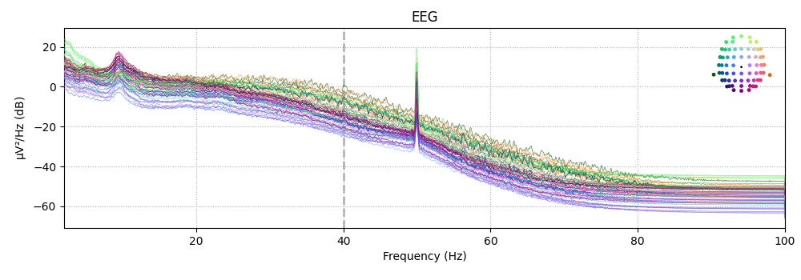
Automatic EEG Preprocessing with FASTER and MNE
Lyndon Rakusen

Slide 20
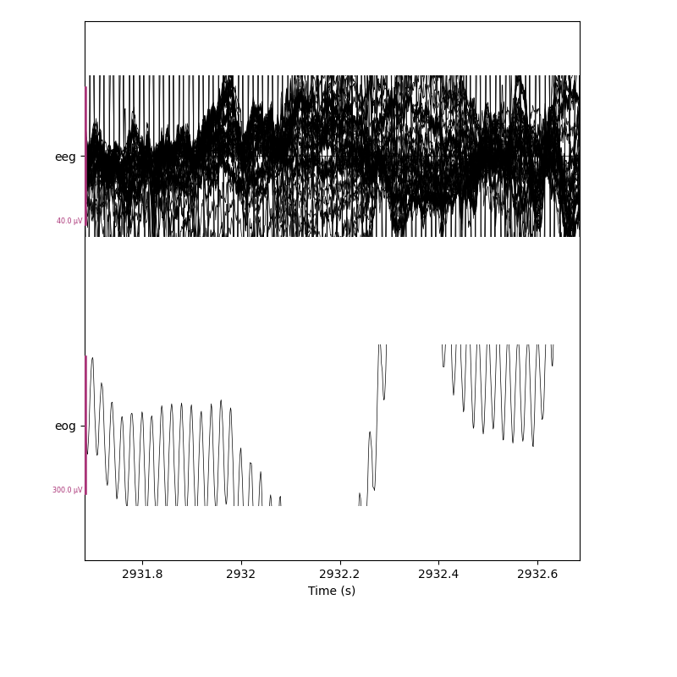
Read, resample, and bandpass raw
Bandpass (iir): 0.5 Hz – 40 Hz
Sample rate: 1000 Hz to 200 Hz
(upper limit of activity is ~100 Hz)
Add montage

Slide 21
Read, resample, and bandpass raw
Bandpass (iir): 0.5 Hz – 40 Hz
Sample rate: 1000 Hz to 200 Hz
(upper limit of activity is ~100 Hz)
Add montage

Slide 22
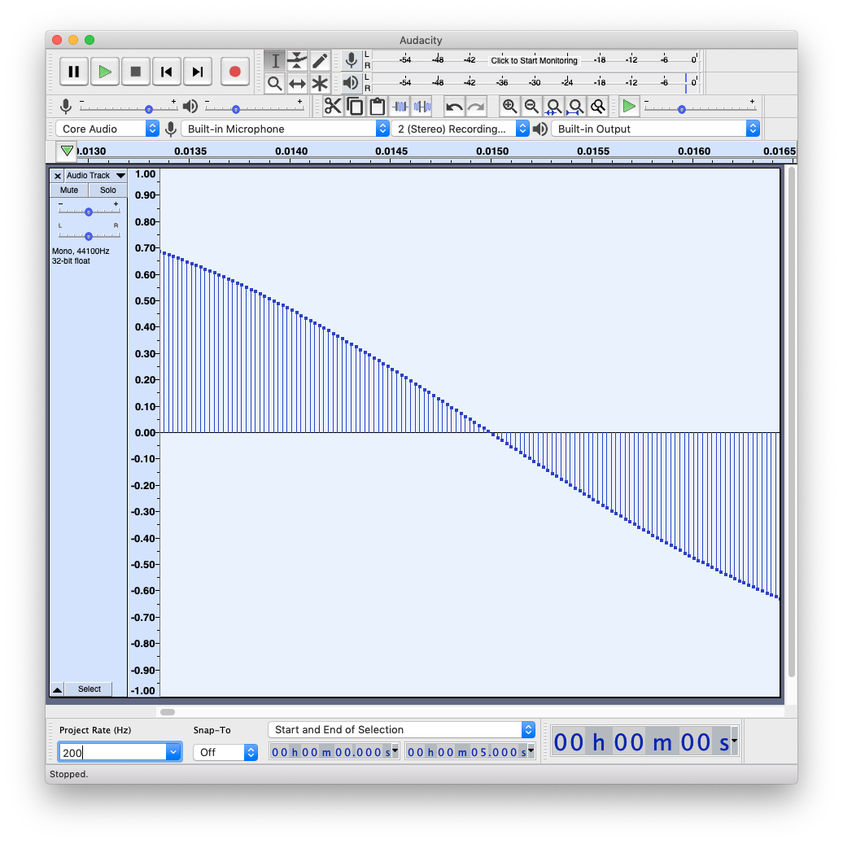
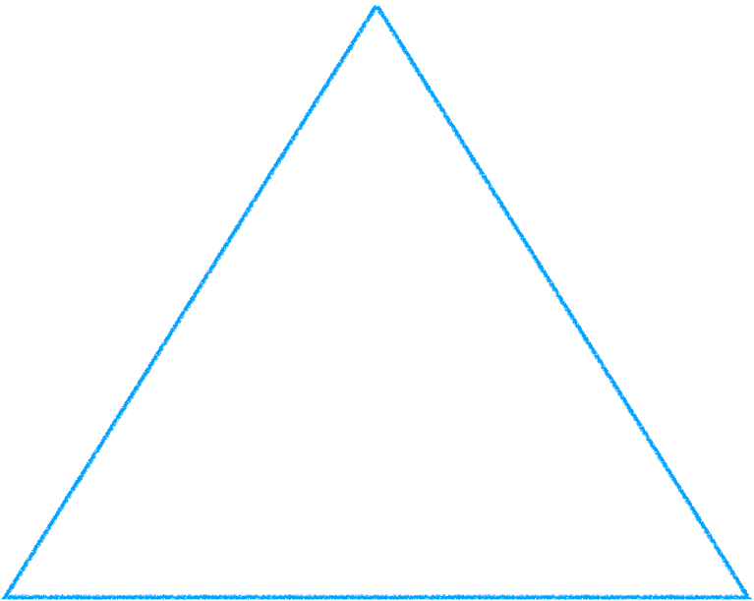
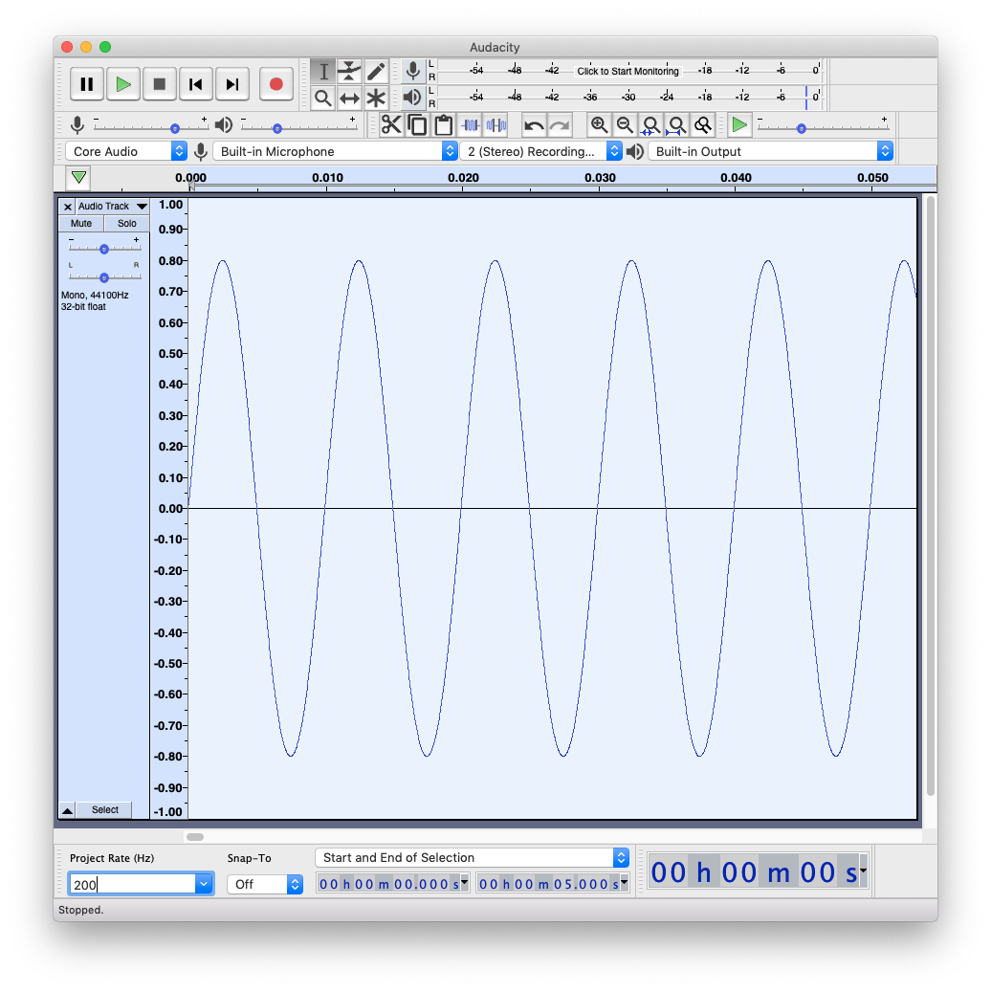
Frequencies & Sampling

Slide 23
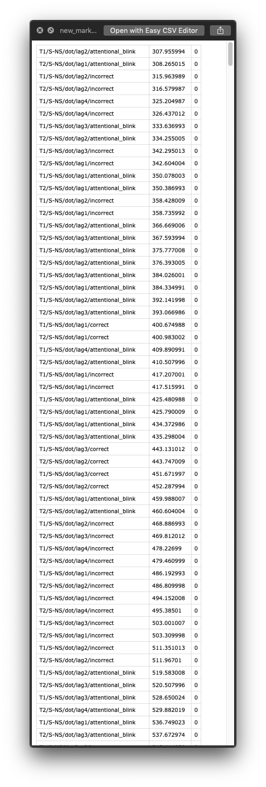
Split into Epochs with custom events
For Attentional Blink EEG:
Baseline (-200ms)
Event & Baseline end (0ms)
Epoch end (+800ms)
Set EEG reference (average)

Slide 24
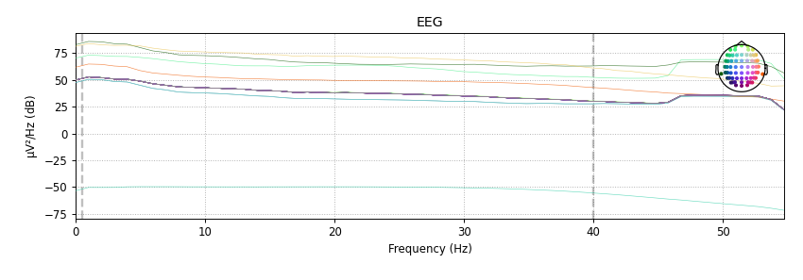
Power Spectral Density (PSD) of Epochs Before

Slide 25
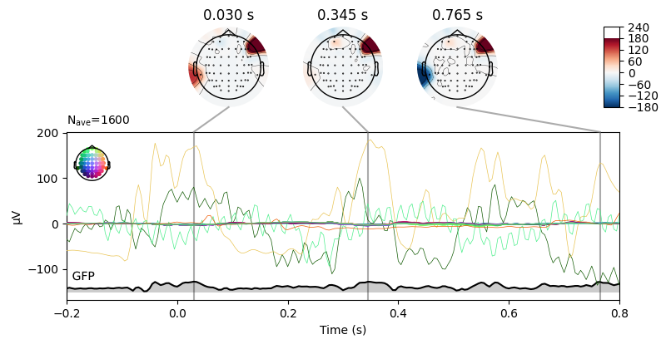
Evoked Before

Slide 26
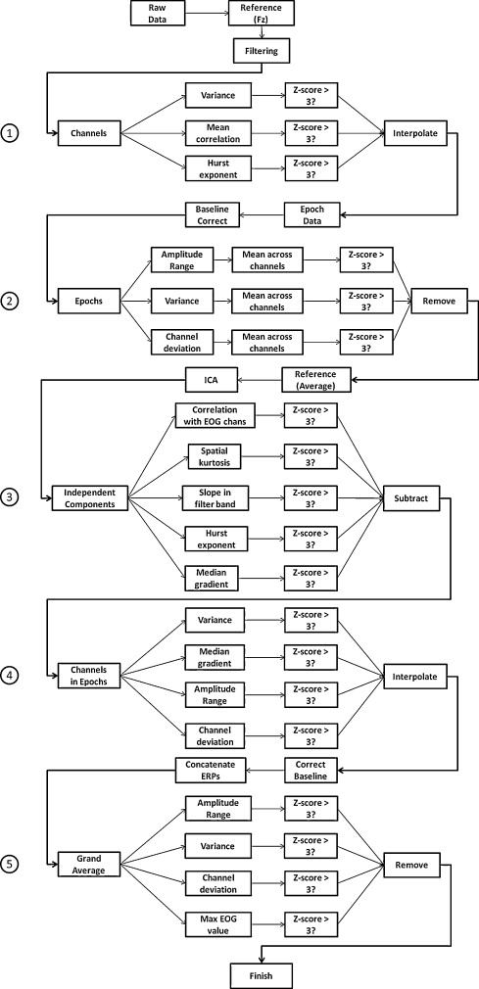
The FASTER Protocol
Step 1: mark bad channels
Variance, correlation, hurst, kurtosis, line noise
Interpolate
Step 2: mark bad epochs
Amplitude, deviation, variance
Drop
Step 3: mark bad ICA components
EOG
Subtract
Step 4: mark bad channels for each epoch
Amplitude, deviation, variance, median gradient, line noise
Interpolate
Extra step 40Hz FIR filter
https://www.sciencedirect.com/science/article/pii/S0165027010003894

Slide 27
Power Spectral Density (PSD) of Epochs Before

Slide 28
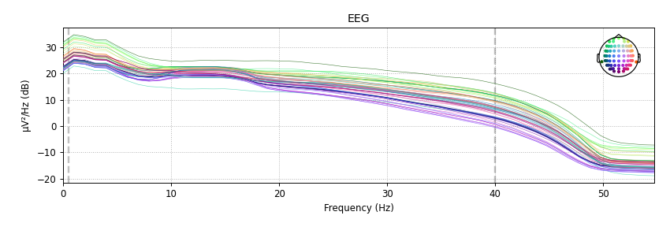
Power Spectral Density (PSD) of Epochs After

Slide 29
Evoked Before

Slide 30
Evoked After

Slide 31
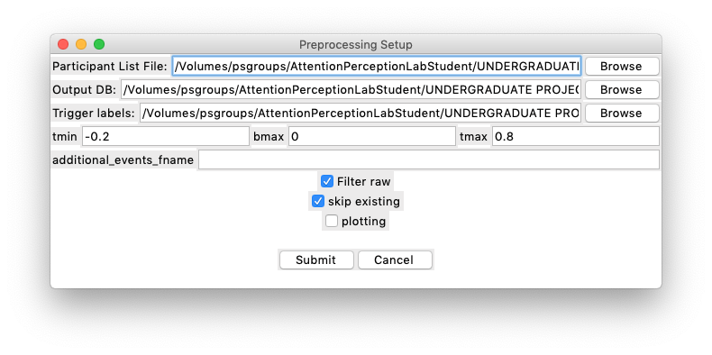
Running EEGpykit.preprocessor
Has a handy run GUI.
leave additional_events_fname blank.
Will bandpass filter all data first, then it will FASTER preprocess data.

Slide 32
Preprocessing Output
3 files per participant/session:
Report file (.html)
Has figures and stats from preprocessing
Preprocessed epochs - (.epo.fif)
Can be opened in Brainstorm with some event label finagling…
Used for our MVPA analysis
Preprocessed pickle file (.pickle)
Most likely won’t need this, but also contains filtered raw and epochs.
Can be read in python

Slide 33
EEG Analysis Tutorial
CCPL - Lyndon Rakusen

Slide 34
Analysis with MVPA
Multivariate Pattern Analysis (or Multi Voxel in fMRI)
Behaviour and stimuli have neural representations.
Therefore theoretically we can discriminate between neural activity in one condition vs another.
Broad term for lots of similar techniques.
We’ll be using my script: EEGpykit/MVPA/MVPA_analysis.py
https://mne.tools/stable/auto_tutorials/machine-learning/50_decoding.html#temporal-decoding

Slide 35
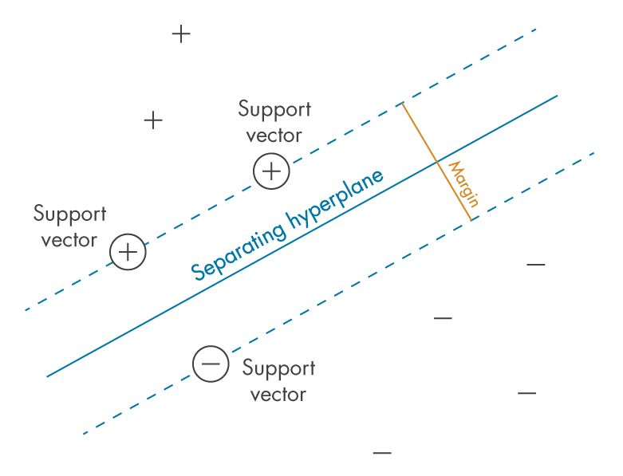
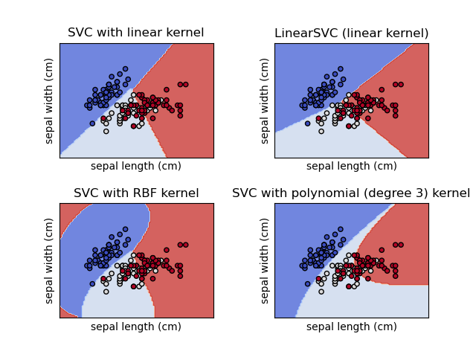
SVM
Support vector machines (SVMs)
Draws an hyperplane that optimally divides the data into groups.
e.g. a 1d line in 2d space, a 2d line in 3d space, etc.
Our EEG data is:
Epochs x Channels x Times

Slide 36
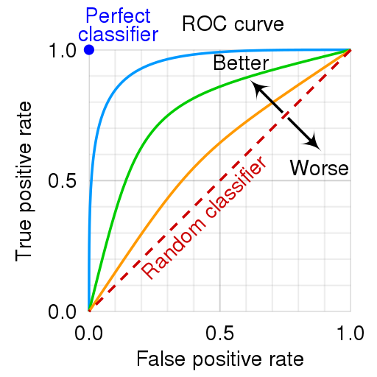
Sliding Estimator
X: Fit an SVM to epochs x channel data, for each time point.
y: Each epoch is assigned a value of 1 or 0, depending on what condition it belongs to.
The SVM tries to determine which condition the epoch belongs to for each time point.
Derive AUC (area under ROC curve) score for each time point.

Slide 37
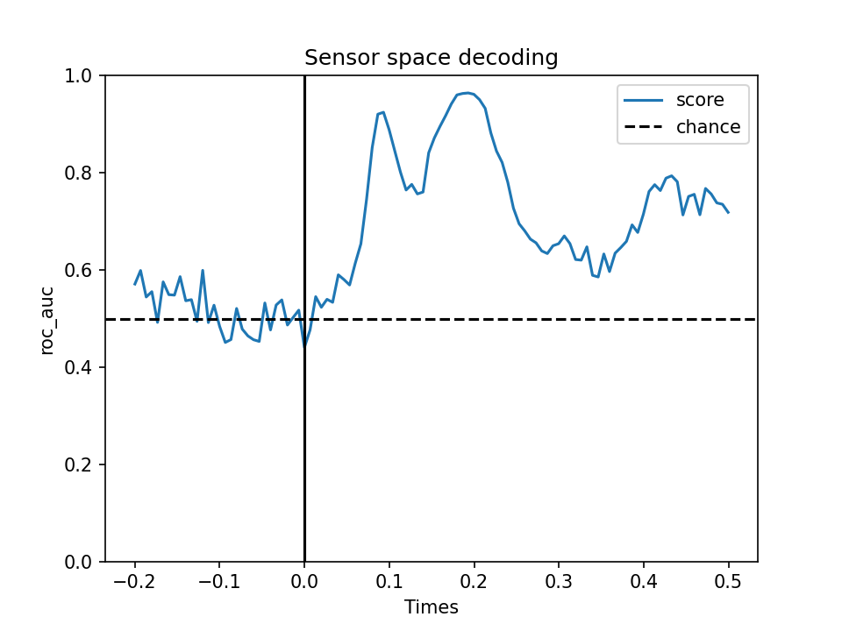
Sliding Estimator
If the SVM can discriminate between conditions we should see higher than chance (0.5) after times 0.
We could do this for each participant and plot the average curve and error.

Slide 38

Group MVPA Analysis
Two options:
Fit a sliding estimator to each participant - average the result
OR
Fit a sliding estimator to all the data

Slide 39
LOGO Cross Validation
Leave One Group Out
The Sliding Estimator is trained on every participant except one
The estimator model is tested on the data from the participant that is ‘left out’
Everyone gets a turn at being the test data
The results are the average test scores across time
Test
Train

Slide 40
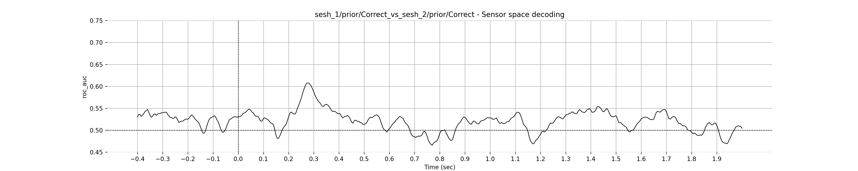
Group MVPA Analysis
Which should look something like this:
Can detect a difference
Can detect a difference but not as consistently
Can’t detect a difference

Slide 41
An Example Analysis
Does viewing a normal mammogram elicit a different response to an abnormal mammogram?
Condition 1: [‘Normal’]
Condition 2: [‘Obvious’, ‘Subtle’]

Slide 42
Signal Analysis
What does the data look like?
Calculate the absolute difference between conditions
Plot a new line that is the difference
When done for every channel you get a grid
Condition 1
Condition 2
+ΔµV
-ΔµV

Slide 43
